Slide 1

Yield Curve Analysis: Predicting Asset Price Movements
Jan Cichocki & Betrand Badinga

Slide 2

Motivation & Summary
About
Motivation: Our project delves into the intricate dynamics of the financial world, focusing on the yield curve's impact on key asset markets like the S&P 500 and real estate. We aim to decode the signals sent by bond markets and their predictive power over asset price movements.
Summary: We hypothesize that movements in the yield curve, particularly the un-inversion, historically signal shifts in asset prices. Our exploration uses a blend of data from Treasury yields, the S&P 500 Index, and the Case-Shiller Home Price Index to validate this hypothesis and uncover underlying trends.

Slide 3

Questions & Data
Problem
How does the yield curve, specifically the spread between 2-year and 10-year Treasury bonds, influence the S&P 500 and real estate markets? Can changes in the yield curve serve as a predictor for the performance of these asset classes?
Data Sources:
Treasury Yields: Data on 2-year and 10-year Treasury bond yields were obtained from Federal Reserve Economic Data (FRED).
S&P 500 Index: Historical data for the S&P 500 Index was sourced from Yahoo Finance.
Case-Shiller Home Price Index: This index, representing the real estate market, was also acquired from FRED.

Slide 4

Data Cleanup & Exploration
Initial Data Inspection
We began by examining the raw data from FRED and Yahoo Finance, identifying any inconsistencies or missing values.
Data Resampling
To align our datasets, we resampled the Treasury yield and Case-Shiller Index data to a monthly frequency.
Yield Spread Calculation
The yield spread was computed by subtracting the 2-year Treasury bond yield from the 10-year yield, providing a measure of the yield curve's shape.
Normalization
For comparative analysis, we normalized the yield spread, S&P 500, and Case-Shiller Index data to their initial values.

Slide 5

Key Insights
Data Challenges
We encountered some missing values, particularly in older records, which we addressed through data interpolation where appropriate.
Tools Used
Python libraries such as Pandas for data manipulation and Matplotlib for visualization were instrumental in our data exploration process.
In our project, we used the pandas_datareader library to access financial data from sources like the Federal Reserve Economic Data (FRED). This allowed us to efficiently gather and analyze long-term trends in Treasury bond yields and the Case-Shiller Home Price Index, forming the basis of our financial market analysis.

Slide 6

Analysis Approach
Time Series Analysis: We conducted a detailed time series analysis of the yield curve, S&P 500 Index, and Case-Shiller Home Price Index, exploring their trends over time.
Correlation Study:
To understand the relationship between the yield curve and asset prices, we analyzed the correlation between the yield spread and the movements in the S&P 500 and real estate markets.
Statistical Analysis:
Utilizing statistical methods, we quantified the strength and significance of the relationships observed.

Slide 7
Key Techniques & Findings
Python's Statistical Libraries We leveraged Python's statistical libraries for in-depth analysis, including correlation coefficients and regression analysis.
Visualizations Graphical representations such as line plots and scatter plots were used to illustrate our findings, making complex relationships more comprehensible.
Asset Price Sensitivity Graphical representations such as line plots and scatter plots were used to illustrate our findings, making complex relationships more comprehensible.
Predictive Indicators The yield curve's movements, especially the inversions and steepening, emerged as potential predictive indicators for future trends in these markets.

Slide 8
Interpreting the Results
Problem
The yield curve served as a significant economic indicator, particularly in forecasting downturns in the S&P 500 and real estate markets following yield curve inversions. Stock Market Sensitivity: Our analysis highlighted that the stock market often reacts negatively to an inverted yield curve, indicating potential future economic slowdowns.
Real Estate Market Trends: Similarly, the real estate market showed trends of price adjustment in response to yield curve inversions, with delays in reaction observed.
Unexpected Insights:
Lag in Market Reaction: Interestingly, there was often a delay between yield curve movements and market reactions, indicating a window of opportunity for informed investment decisions.
Varied Impact Across Markets: The impact of yield curve movements varied between the stock and real estate markets, suggesting a nuanced approach to interpreting these indicators.

Slide 9
Analysis
Data Synchronization
Aligning data from different sources (Treasury Yields, S&P 500, Case-Shiller Index) was challenging. We overcame this by resampling data to a uniform monthly frequency.
Data Gaps
We encountered missing values in our datasets. We addressed this by using appropriate data imputation techniques where feasible.
Exploring Additional Indicators
The yield spread was computed by subtracting the 2-year Treasury bond yield from the 10-year yield, providing a measure of the yield curve's shape. In the future, we would like to incorporate more economic indicators, such as unemployment rates and GDP growth, to enhance our analysis.
Longer Time Frame
Extending the analysis over a longer period could provide deeper insights into long-term trends and cycles.

Slide 10
Final Takeaways
Interconnectivity of Markets: Our analysis illustrates the intricate relationship between the bond market, stock market, and real estate market, emphasizing the interconnected nature of financial systems.
Predictive Power of Yield Curve: The yield curve, particularly the spread between 2-year and 10-year Treasury bonds, is a powerful tool in forecasting economic trends and their subsequent impact on asset prices.
Our journey through data has unveiled how shifts in bond yields can prelude significant movements in the stock and real estate markets. Understanding these patterns not only helps in making informed investment decisions but also in grasping the broader economic narrative.

Slide 11
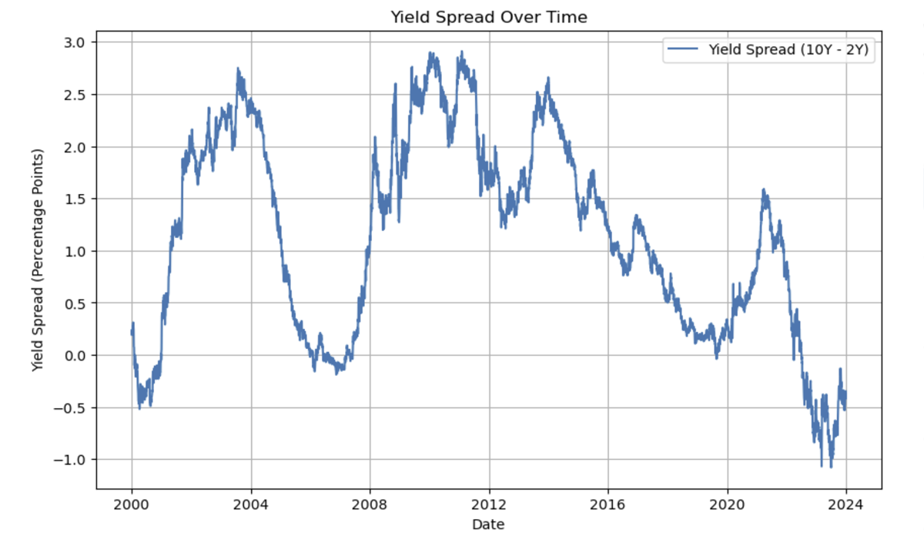

Slide 12
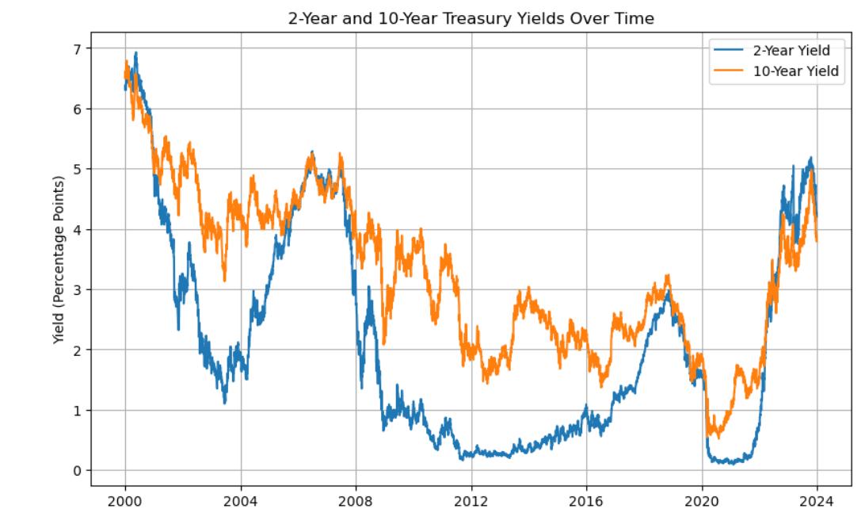

Slide 13
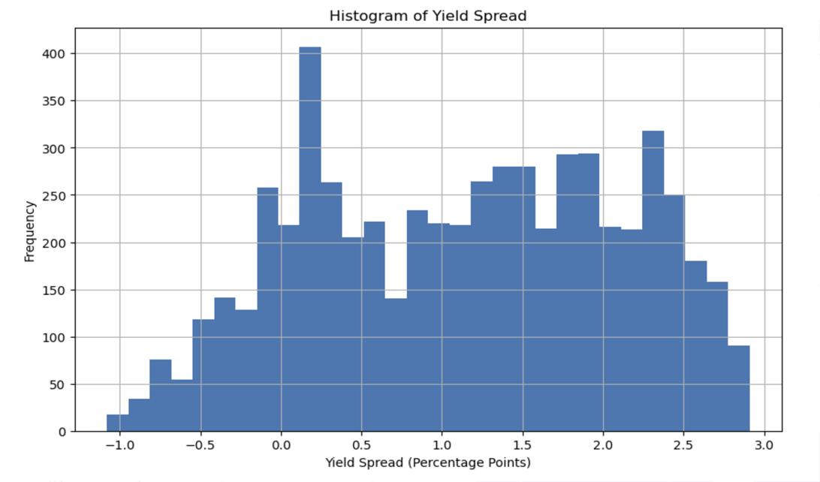

Slide 14
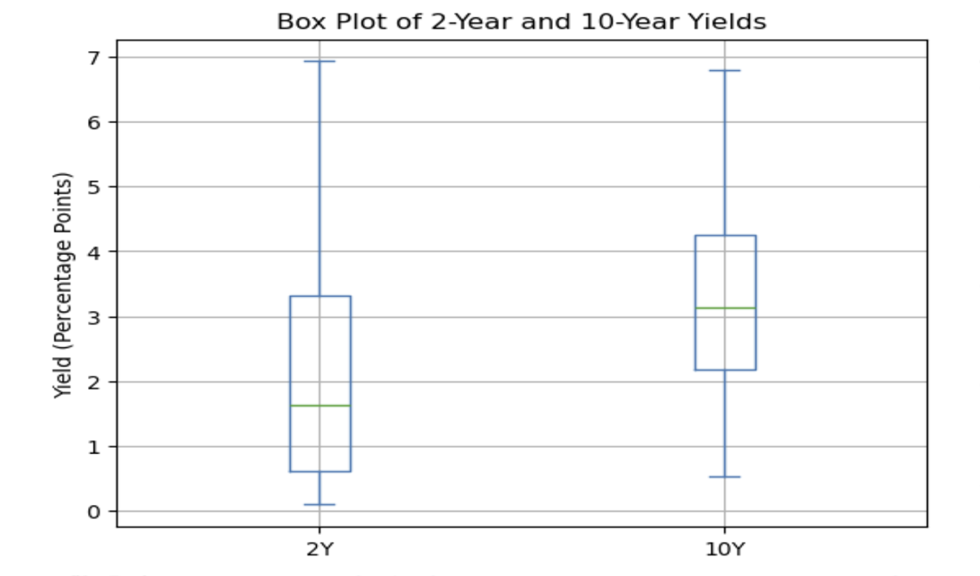

Slide 15
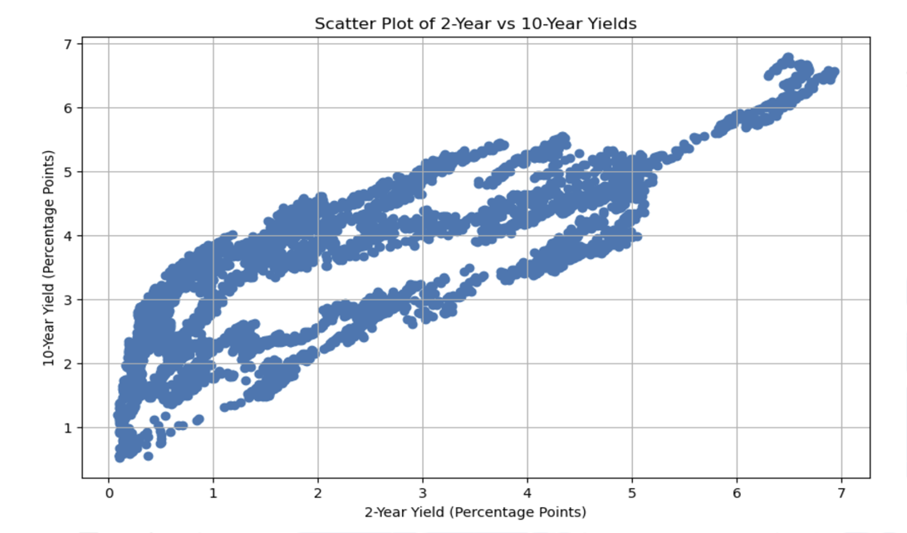

Slide 16
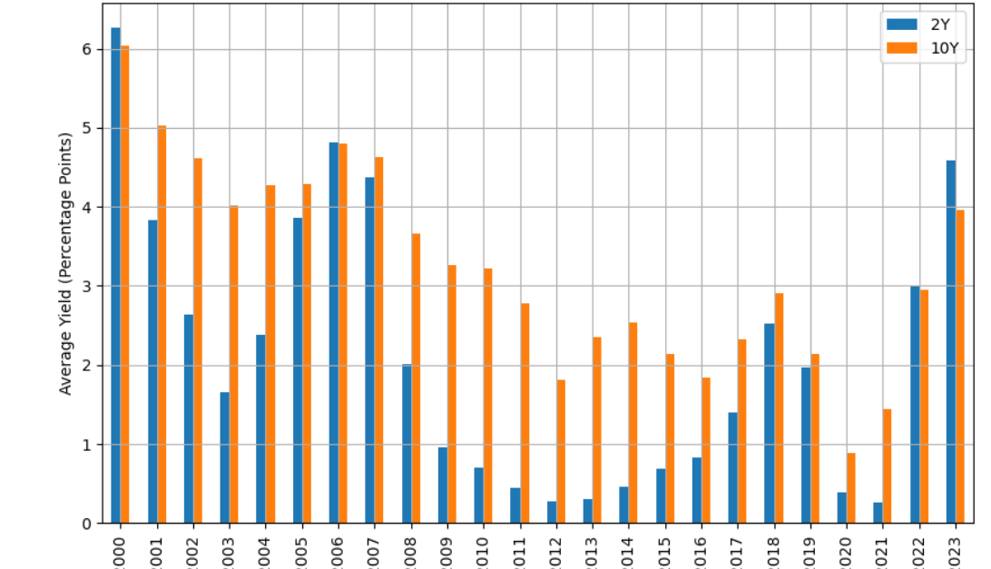

Slide 19
Data Access
Treasury Yields (2-year and 10-year): We accessed the Treasury bond yields data from Federal Reserve Economic Data (FRED) using the pandas_datareader library. The data includes daily yield values for both the 2-year (DGS2) and 10-year (DGS10) Treasury bonds.
S&P 500 Index Data: We used the yfinance library to fetch historical data for the S&P 500 Index (ticker symbol: "^GSPC"). This data provides us with detailed stock market movements over time.
Case-Shiller Home Price Index: Similarly, the Case-Shiller Home Price Index data was obtained from FRED using pandas_datareader. This index tracks changes in the value of the residential real estate market.

Slide 20
Python Code for Data Access
import pandas as pdimport pandas_datareader as pdr
import yfinance as yf
import datetime
# Define date range
start = datetime.datetime(2000, 1, 1)
end = datetime.datetime(2024, 1, 1)
# Treasury Yields from FRED
data_2y = pdr.DataReader("DGS2", 'fred', start, end)
data_10y = pdr.DataReader("DGS10", 'fred', start, end)
# S&P 500 Data from Yahoo Finance
sp500_data = yf.download("^GSPC", start=start, end=end)
# Case-Shiller Home Price Index from FRED
cs_data = pdr.DataReader("CSUSHPINSA", 'fred', start, end)

Slide 21
Python Code for Data Cleaning
# Resample Treasury yield data to monthly frequency
data_2y_monthly = data_2y.resample('M').last()
data_10y_monthly = data_10y.resample('M').last()
# Calculate the yield spread
combined_data = pd.DataFrame({'2Y': data_2y_monthly['DGS2'], '10Y': data_10y_monthly['DGS10']})
combined_data['Spread'] = combined_data['10Y'] - combined_data['2Y']
# Resample S&P 500 data to monthly frequency
sp500_monthly = sp500_data['Adj Close'].resample('M').mean()
# Normalize the Case-Shiller Index
cs_data_monthly = cs_data.resample('M').last()
cs_data_normalized = (cs_data_monthly / cs_data_monthly.iloc[0]) * 100

Slide 22
GitHub Links
Main Readme.md File
https://github.com/jancichocki/Predictive_Analysis_Of_Real_Estate/blob/main/README.MD
2-10 Yield Graphs
https://github.com/jancichocki/Predictive_Analysis_Of_Real_Estate/blob/main/2_10_Graphs.ipynb
S&P Comparison
https://github.com/jancichocki/Predictive_Analysis_Of_Real_Estate/blob/main/Yield_Curve_SP500.ipynb
Case–Shiller Comparison
https://github.com/jancichocki/Predictive_Analysis_Of_Real_Estate/blob/main/Yield_Curve_SP500.ipynb

